Slide 1


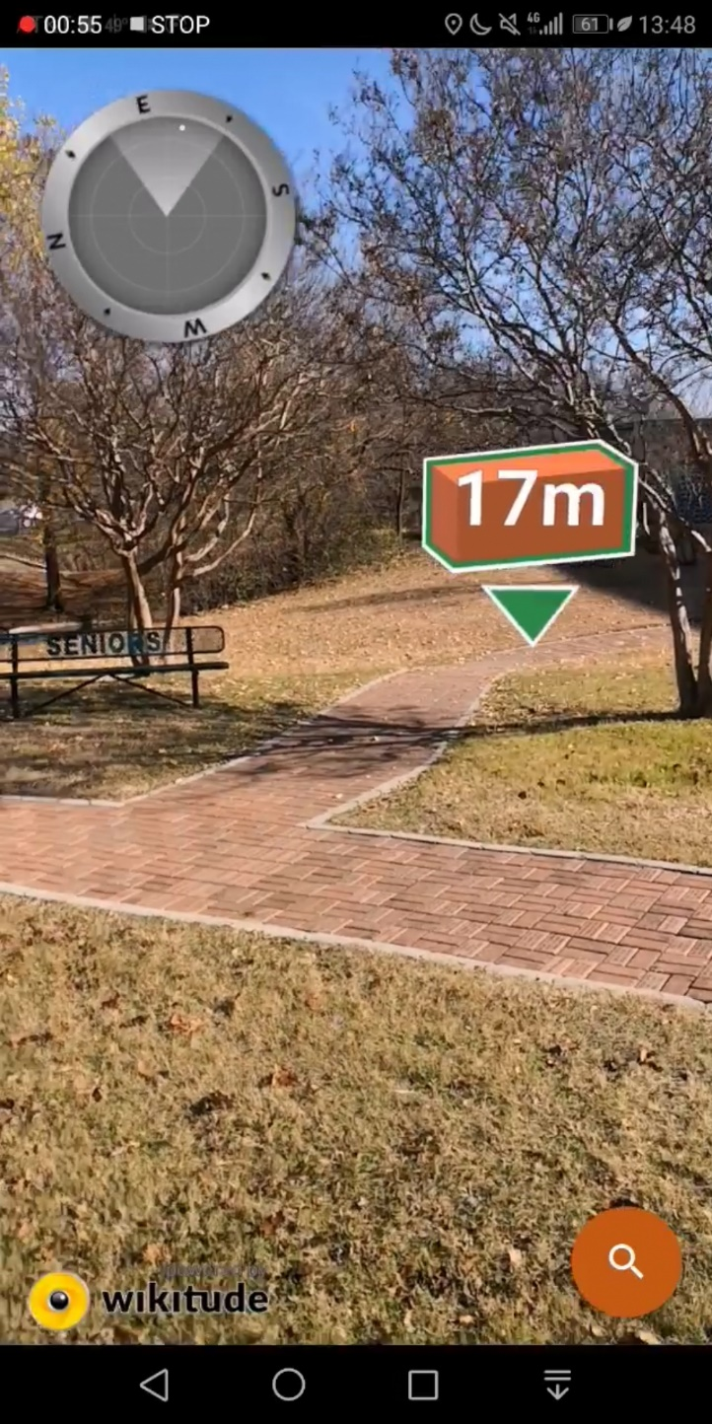
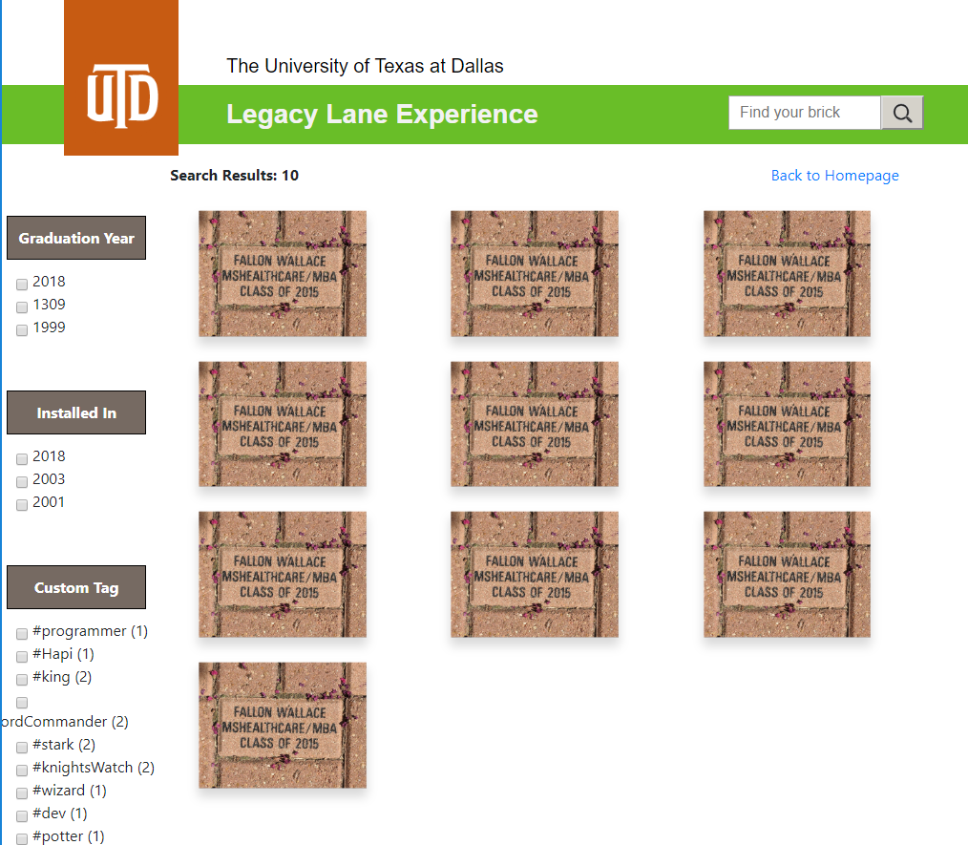
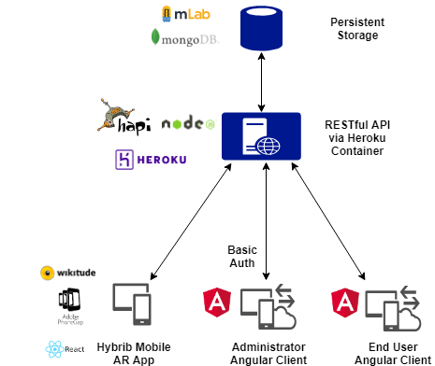
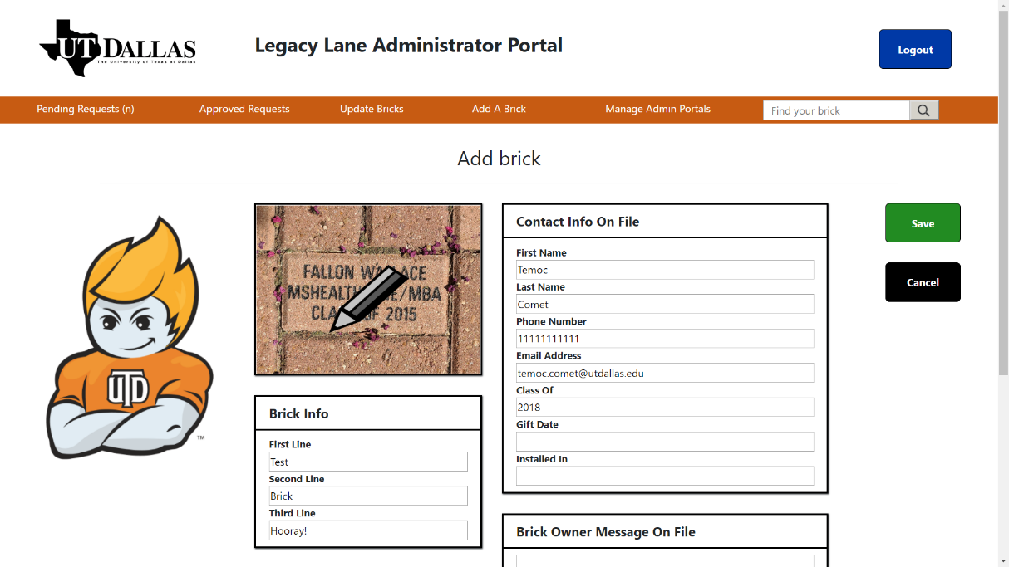
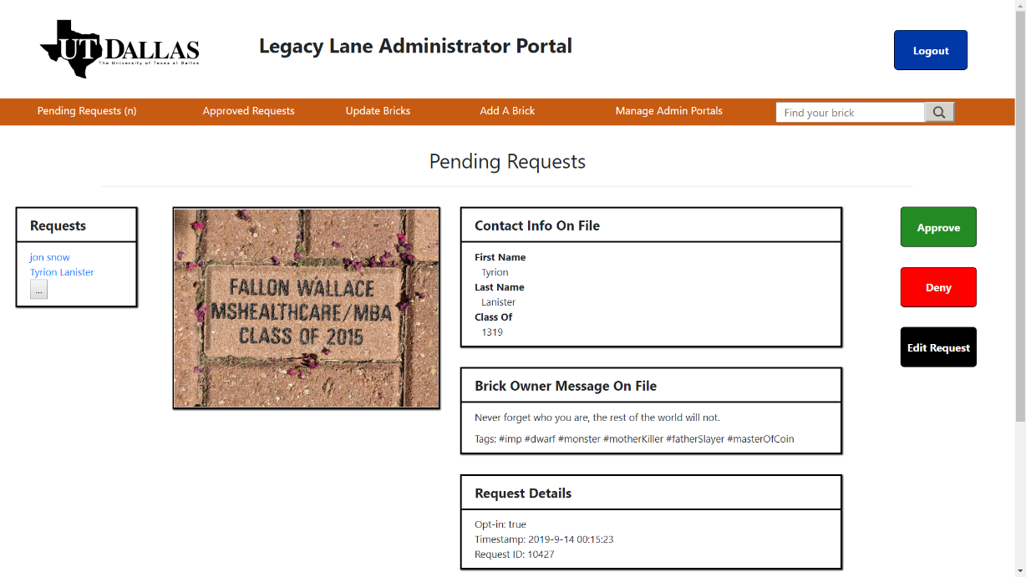
UTD Legacy Lane
Hybrid Mobile AR App and Client Applications Utilizing a RESTful API
Daniel Casper, daniel.casper@utdallas.edu; Lucas Castro, lucas.castro@utdallas.edu; Devon Hayworth, devon.hayworth@utdallas.edu; James Speights, james.speights@utdallas.edu; Marie Standeven, marie.standeven@utdallas.edu
CS 4485 / Fall 2019
Department of Computer Science
Erik Jonsson School of Engineering & Computer Science
The University of Texas at Dallas
Richardson, TX 75080, USA
Abstract
Results
Create an Augmented Reality (AR) based application that enables the user to navigate through Legacy Lane and view additional information associated with specific bricks, a site application for the user to view their bricks remotely and to submit a form request to add info to their brick, and an admin site application to monitor the request forms and update the database. Our solution was to write an AR app using React and Wikitude, a website and the admin portal using Angular, and an API using MongoDB and Hapi.JS. The purpose of this project it to create value for University of Texas at Dallas (UTD) Alumni Relations by encouraging alumni donations through this software experience.
Keywords: VR/AR, Mobile App, GeoLocation
Results of search feature on End User Angular application.
Architecture
Hybrid Mobile App using AR and geolocation services to locate a donor’s brick.
Client Applications
Two Angular.JS front end applications are used for Administrators and End Users. The Administrator app allows updates to data and requires authentication. The End User app allows users to make requests and view data.
Hybrid Mobile AR Application
The mobile application is cross-compiled for Android and iOS using Adobe PhoneGap. React is used to structure the application, and the AR toolkit, Wikitude, provides location, image detection, and 3D model rendering.
RESTful API via Heroku
The backend API is built using the Hapi.JS framework, a web framework for Node.JS, and runs n Heroku. Basic auth supports access control for protected administrator routes. All communication with the API is encrypted.
mLab MongoDB Database
MongoDB provides persistent storage. Text indexes support search. Only the backend API can communicate with the database over an encrypted connection.
Form to create a brick in the Administrator Angular application.
Form to approve, deny, or modify end user requests in the Administrator Angular application.
Impact
Summary
Administrators can update brick information in real-time
Alumni, donors, and guests can now find their donated brick
Alumni, donors, and guests can update their brick information
Link to brick donation page on End User Application to increase donation of additional bricks to Legacy Lane
Hybrid mobile apps can deliver performance required for AR applications, reducing development and maintenance
GPS accuracy is limited; precise navigation within 3 meters requires beacon technology or anchor objects at site
Heroku provides a simple way to host and deliver software, including database add-ons, continuous integration, and SSL support
Hapi.JS provides rich ecosystem of tools which support OpenAPI documentation, testing, and model validation
The latest version of the Angular framework is highly extensible, reducing the effort to add new features or change services components consume
Performance
Able to navigate users to within 3 – 7 meters of a brick using GPS
UTD brand standards were observed throughout UI development
All functional goals were met for mobile, web, and backend applications
Data in-transit and passwords are encrypted
Strict model validation on all payload and response objects

